Slide 1
Data Model for VivaK
Group C
Sajeevan Kumarasamy
Charles Leslie Selase Kotobridja
Soyebal Saad AdnanJames Musiime
James Musiime

Slide 2
Introduction
VivaK is a successful retail chain in the fashion industry, the head office of which is located in Southlake, Texas, USA
The current information system of HR department is not well maintained and, also the data stored in various file formats
Hence, HR manager intends to implement an Online Analytical Processing (OLAP) Database to support HR analytics

Slide 3
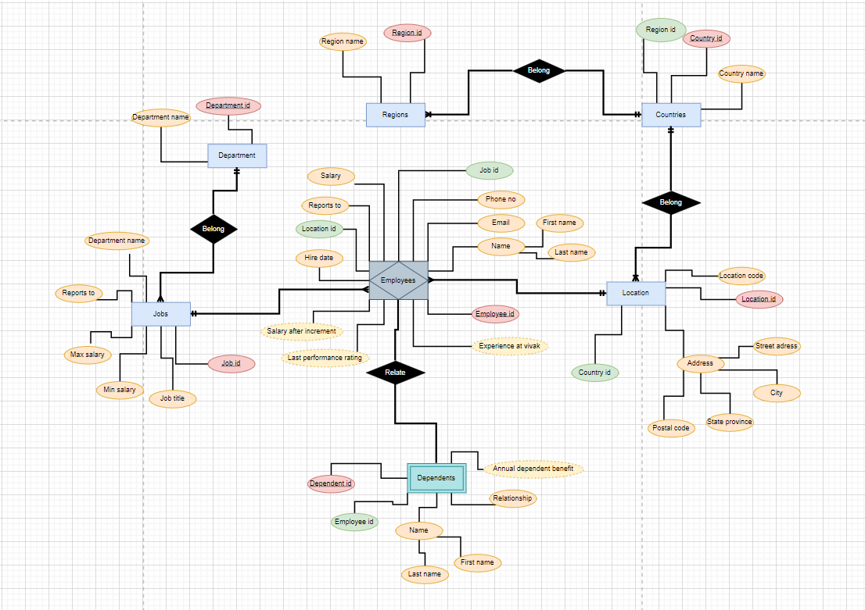
Data Model of VivaK
Data model for VivaK has been designed by identifying the Entities, Attributes, Primary Keys, Foreign Keys and relationship between entities
The following 7 entities have been identified:
Regions
Countries
Locations
Jobs
Departments
Employees
Dependents

Slide 4
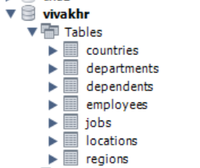


VivaKHR schema
Based on the above data model scheme VivaKHR has been created
The following has been taken into consideration when creating the schema
Data Type of the salary related columns are double and recorded in 2 decimals
Data type of the ID columns and related foreign keys is Integer
Employee table must contain the ‘report_to’ column
Data type of columns which recorded date is Date

Slide 5

VivaKHR schema
The following columns are added to table Employees
experience_at_VivaK - the number of months that each employee has worked at VivaK
last_performance_rating - the performance rating of each employee after the annual performance appraisal
salary_after_increment - salary anticipated after the annual performance appraisal
The following column is added to table dependents
annual_dependent_benefit - the dependent bonus that each employee receives per dependent

Slide 6
Import data to tables
Data has been imported to data base VivaKHR from the formats database HR, Jason file and CSV file
In given data for table dependents, the dependent id was not correct as it has duplicates id which should not be as dependent id is the Primary Key. Hence, the auto increment type was used to generate dependent id instead of importing it from given data

Slide 7


Clean the data – Handle duplicates
Table locations has two columns location_id and location-code with the same type of data. Hence, the duplicate column location_code was removed from the table
Each table has been tested using ‘count’ function to ensure the unique column should not have duplicates entries
In this instance, street address cannot have duplicates, therefore the query written in a way that it returns the values if the column has any duplicate address

Slide 8
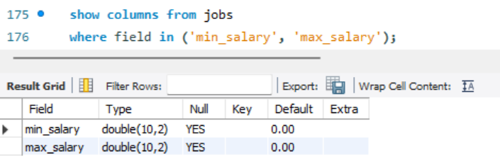
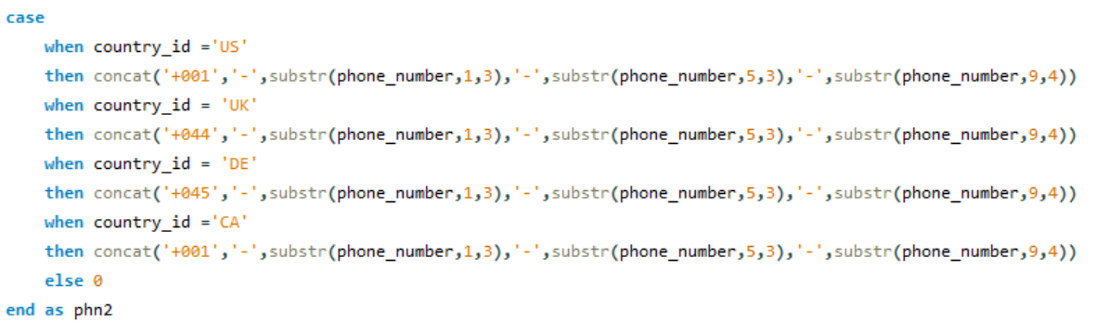
Clean the data – Data formatting
The floating-point data is represented as double
phone numbers are all recorded in the format: ‘+000-000-000-0000’
Each column which is used to store float data has been checked for data type
Phone number from table employees has been updated with the format ‘+000-000-000-0000’ with country code based on country by joining table with table locations

Slide 9
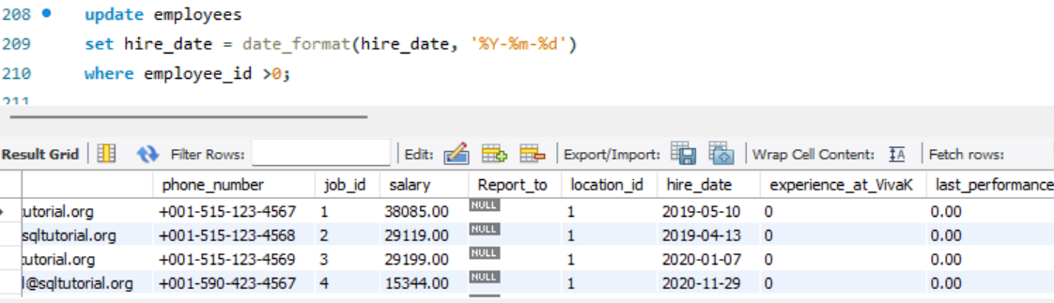
Clean the data – Data formatting
Columns which record date has been in the format of ‘yyyy-mm-dd’
Function date_format has been used to format the date column in specific format

Slide 10
Missing Value Treatment
Table employees – Column report to
The following approach has been used to update column report_to from table employees
Table employees was joined by job_id with table Jobs to get the Job id of each employee’s manager
Then the derived table was joined with table employees by location_id and job_id to identify the employee_id of each employee’s manager
Then the above derived table was joined with the table employees by employee-id to update report_ to column

Slide 11
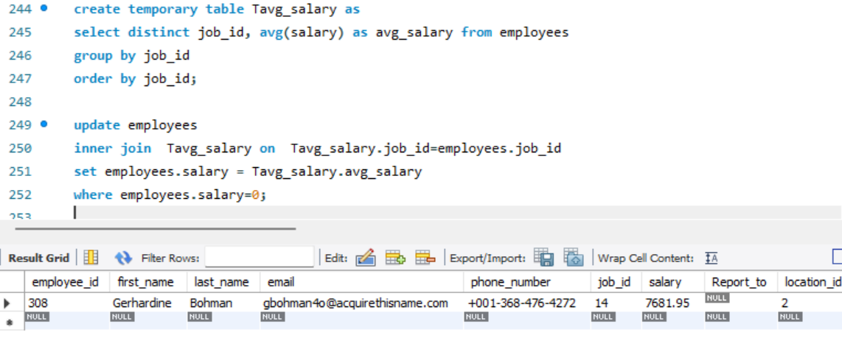
Missing Value Treatment
Table employees – Column salary
It was noticed salary was missing for 193 employees in table employees
The following approach was used to update salary for employees whose salary is missing
Average salary was calculated based on job id as the salary depends on the job title each employee entitle to
Missing value was filled with average salary calculated above based on the job id

Slide 12
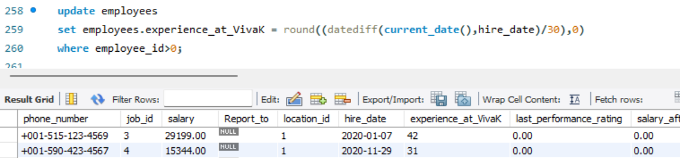
Update Table - employees
Table employees was updated with following calculation
Column - experience_at_VivaK: Time difference (in months) between the hire date and the current date for each employee
datediff function was used calculate the time in days between hire date and current date and then it was divided by 30 to get number of months

Slide 13
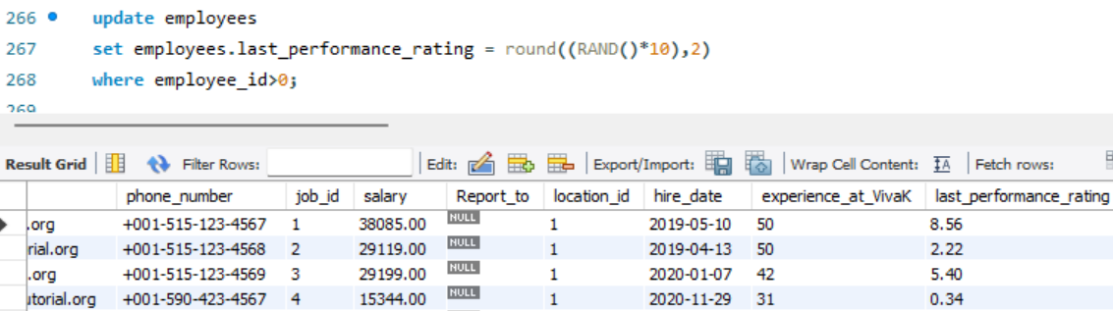
Update Table - employees
Column - last_performance_rating: Generate a random performance rating figure (a decimal number with two decimal points between 0 and 10) for each employee
Round function was used generate random numbers and it was multiplied by 10 to get the number between 0 and 10

Slide 14
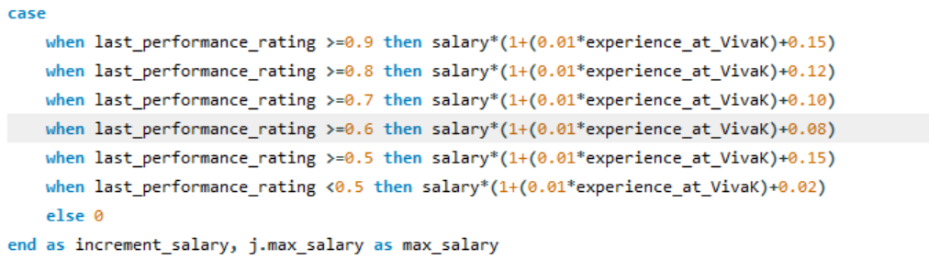
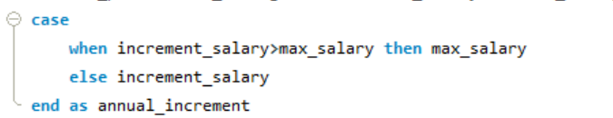
Update Table - employees
Column - salary_after_increment: Salary after the performance appraisal
The following approach was used:
Salary increment was calculated based on the increment slabs provided
Salary after increment was decided by considering the salary range for each job. If the salary increment is higher than maximum salary then max salary was set as increment else calculated salary increment was set

Slide 15
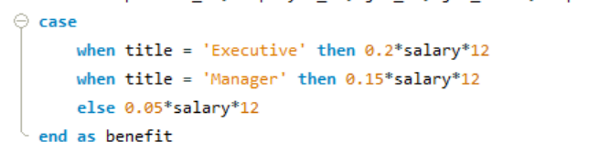
Update Table - dependents
Annual dependent benefit was calculated as per below;
Table depedents was joined with table employees by employee_id and joined with table jobs by job_id to get the job title and department name of employees related to each dependent
Annual dependent benefit was calculated based on the slab provided depend on the title of the employee
The above derived table was joined with the table dependents by dependent_id to update the column annual_dependent_benefit

Slide 16
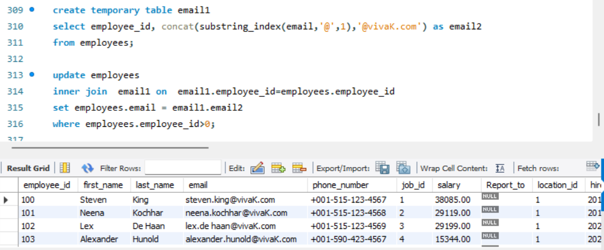
Update Table - employees
Column – email: update email address of each employee with the new domain vivaK.com
Function ‘concat’ and ‘substring’ were used to update the email address with new domain

